Slide 1
Spying into the Heart of Eclipse
Interesting observations from an Eclipse committer
Chris Aniszczyk <zx@us.ibm.com>
PDE Lead
Eclipse Committer
Notes:
Note: Mention that this is focused on plug-in development, not building plug-ins

Slide 2

Procrastination…

Slide 3

Agenda
Background
Plug-in Spy
OSGi Console
Core Tools
Conclusion
Q&A

Slide 4
Background
This talk represents insights from a long-time Eclipse committer…
Eclipse has a high learning curve… why?
Common developer questions:
  “How can I find the source for this cool feature?”
  “How can I contribute to Eclipse? Why is this so hard?”
  “I don’t understand what is going on inside of the Eclipse runtime…”

Slide 5
Agenda
Background
Plug-in Spy
OSGi Console
Core Tools
Conclusion
Q&A

Slide 6
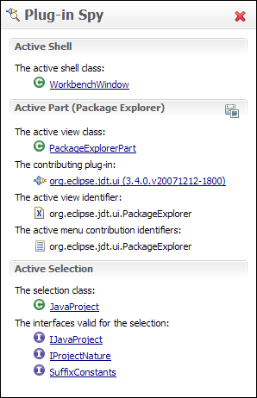
Plug-in Spy
Coming to Eclipse 3.4!
ALT+SHIFT+F1
Allows you to introspect what you’re looking at…
Hyperlinking
Shows contributing plug-ins

Slide 7
Demo
Demo 1 (“How can I find the source for this cool feature?”)
  Error Log View
Demo 2 (““How can I contribute to Eclipse? Why is this so hard?”)
  Patching Eclipse… CVS Selection Deficiency…

Slide 8
Agenda
Background
Plug-in Spy
OSGi Console
Core Tools
Conclusion
Q&A

Slide 9
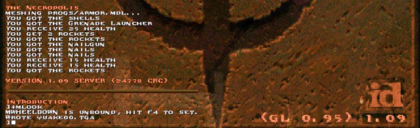
Who remembers Quake?
Useful commands like saving screenshots and cheat codes!
iddqd or idkfa ☺

Slide 10
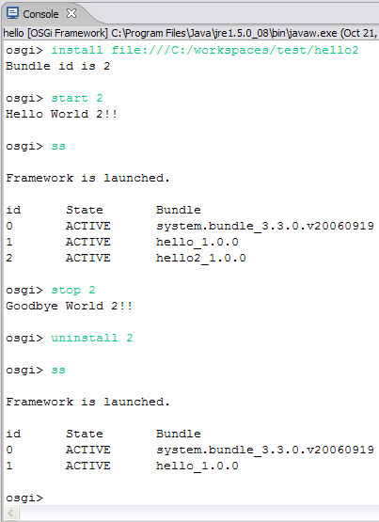
OSGi Console
Kind of like that quake console! ☺
Common commands
  Status
  Start/stop
  Install/uninstall
  diag
Custom Commands

Slide 11
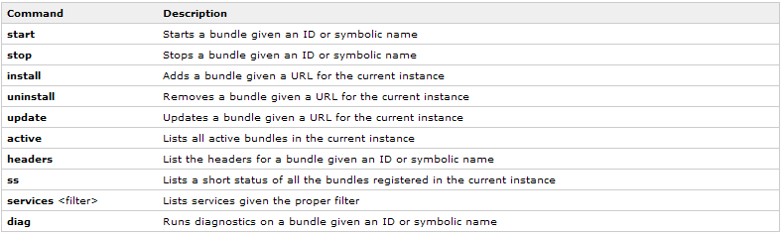
Common Commands

Slide 12
Demo
Demo 1
  Common commands
Demo 2
  uname
  Custom commands*
*http://www-128.ibm.com/developerworks/opensource/library/os-ecl-osgiconsole/

Slide 13
Agenda
Background
Plug-in Spy
OSGi Console
Core Tools
Conclusion
Q&A

Slide 14
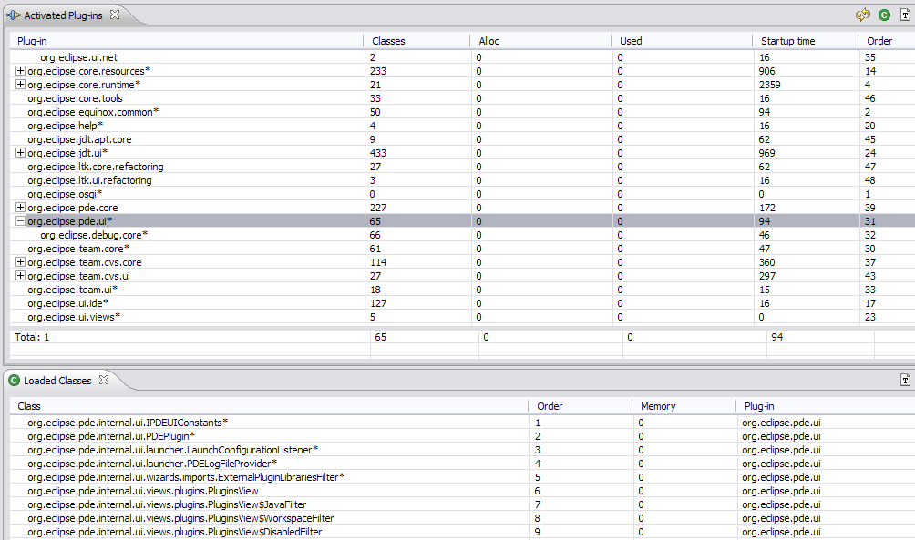
Core Tools
Basic tools to help understand Eclipse runtime
http://wiki.eclipse.org/Core_Tools

Slide 15
Demo
Demo 1
  Runtime Spy Perspective (PDE Plug-ins View Example)
  “I don’t understand what is going on inside of the Eclipse runtime…”
Demo 2
  Metadata Spy Perspective
Demo 3
  Preferences Spy

Slide 16
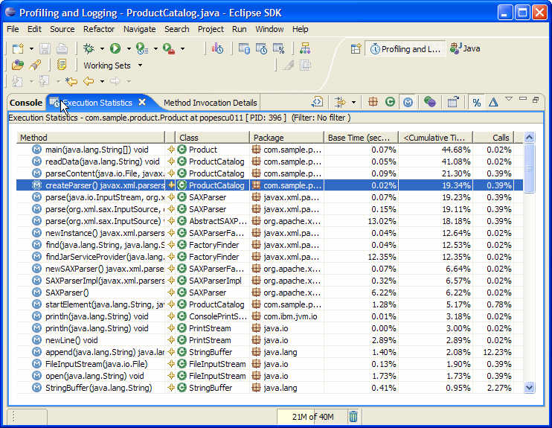
TPTP
Note: There exists more advanced performance tooling in Eclipse…
Test and Performance Tools Platform (TPTP)
  http://www.eclipse.org/tptp
  http://www.eclipse.org/articles/Article-TPTP-Profiling-Tool/tptpProfilingArticle.html

Slide 17
Agenda
Background
Plug-in Spy
OSGi Console
Core Tools
Conclusion
Q&A

Slide 18
Conclusion
There’s a lot to learn from the runtime…
Understanding internals can help with debugging problems like…
  Performance
  Startup Issues
  Classloading Exceptions
Spying into Eclipse is fun and easy!
Now that you know more… think about contributing back!

Slide 19
Agenda
Background
Plug-in Spy
OSGi Console
Core Tools
Conclusion
Q&A

Slide 20
Thank you!
Questions?

Slide 21
Backup Slides
In case audience is completely confused OSGi…

Slide 22

What is OSGi?
OSGi is an independent, non-profit corporation working to define open specifications for the delivery of services to networked small-memory devices.
OSGi Service Platform, Release 4.1 is the latest version of the specification document for a service delivery framework.
The OSGi Service Platform specifications describe a software deployment and configuration management architecture.
On the web at http://www.osgi.org/.

Slide 23
OSGi Goals
Provide a consistent, component-based application programming model.
De-couple a component’s interface from its implementation.
Support multiple implementations of a component’s interface.
Development of components independent of the implementation of other components.

Slide 24
What is a OSGi component?
An OSGi component is an implementor of a Java interface.
OSGi refers to the Java interfaces implemented by a component as services or service interfaces.
Applications are built from collaborating components.
Collaborating components are coupled only via service interfaces.

Slide 25
What is an OSGi Service?
Service
A service is a self-contained component accessible via a service interface.
Services are registered with the OSGi framework, making them available to others. This is sometimes called publishing a service.
Components can acquire services by querying the OSGi framework.
Components must release services back to the OSGi framework when they are finished with them.

Slide 26
Some OSGi Services…
Configuration Admin Service - enables an operator to set the configuration information of deployed bundles.
Device Access - supports automatic detection of attached and detached hardware devices and can automatically download and start appropriate device drivers.
HTTP Service - provides an embedded HTTP server that is capable of serving HTML and servlets.
Log Service - provides a general purpose message logger for the OSGi environment.
Package Admin Service - enables a management bundle to provide the policies for package sharing.
Permission Admin Service - enables a management bundle to administer bundle's permissions and provides defaults for all bundles.
Preferences Service - provides a persistent data store for bundles.
User Admin Service - provides minimum authentication functionality.
Start Level Service - enables a management agent to control the relative starting and stopping order of bundles.
URL Handlers Service Support - enables you to dynamically register multiple URL and Content handler services, which shield bundles from Java limitations.

Slide 27
OSGi Software Architecture
Bundle
Bundle
Bundle
Bundle
Bundle
Bundle
Bundle
Bundle
Bundle
Bundle
OSGi Service Platform
Java Class Library
Java Virtual Machine
Operating System & Device Drivers

Slide 28
What is a bundle?
A bundle is often a JAR file.
A bundle can also be a JXE file.
A bundle can contain services.
A bundle can contain Java packages.
A bundle can export services and Java packages.
A bundle can import services and Java packages.
A bundle can be activated by a BundleActivator.
A bundle always contains an OSGi-specific manifest file
  MANIFEST.MF
Bundle
Packages
Packages
Services
Services

Slide 29
The OSGi Bundle Manifest
Each bundle must contain a manifest file.
The bundle's manifest file contains data that the framework needs to correctly install and activate the bundle.
The headers used in a manifest file must be defined by the OSGi™ specification.
The MANIFEST.MF is located in the META-INF directory of your bundle project.

Slide 30
OSGi Manifest Headers
Bundle-Name
Provides a human readable name for a bundle.
Bundle-SymbolicName
Identifies a bundle. The Bundle Symbolic Name and Bundle Version allow for a bundle to be uniquely identified in the Framework.
Bundle-ClassPath
A comma separated list of JAR file path names (inside the bundle) that should be searched for classes and resources.
Bundle-Activator
The name of the class that is used to start and stop the bundle.
Bundle-Localization
Specifies where the bundle is located.
Require-Bundle
Specifies the specific bundles that provides packages you use in your bundle. If you do not specify the bundle which provides the packages you need, you may get a noClassDefFound exception when the bundle loads.
Import-Package
Specifies the names of any package that you want your bundle to import from the runtime. If you do not specify the package your bundle needs in this header, you may get a noClassDefFound exception when the bundle loads.
Export-Package
Specifies the name of any package that you want your bundle to export to the runtime. If you do not specify the packages needed by other bundles in this header, the dependent bundles may not resolve.

Slide 31

Eclipse and OSGi: A happy marriage!
Eclipse is a universal platform
for integrating components (plug-ins)
Open, extensible architecture
Applications are delivered as plug-ins
  Plug-in - smallest unit of Eclipse function
  Extension point - named entity for collecting “contributions”
  Extension - a contribution
OSGi Fits!
  Plug-in ⬄ Bundle!

